Slide 1
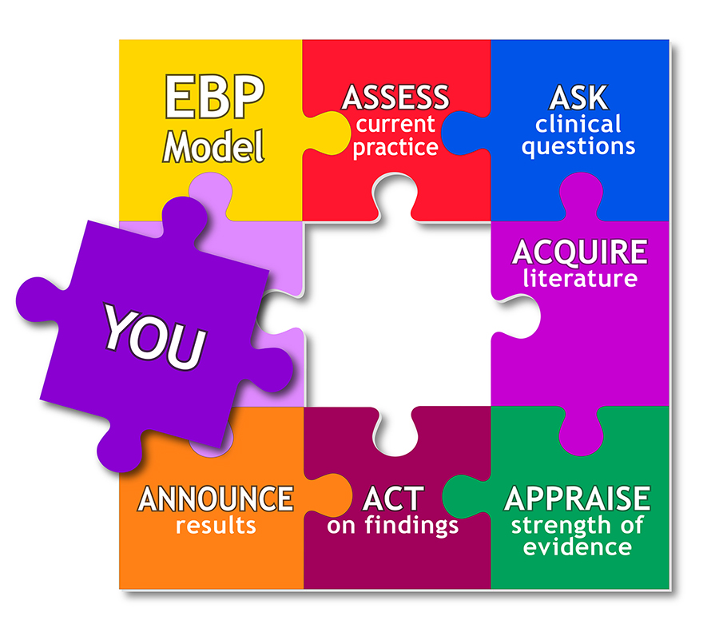
Evidence Based Approaches
Week 8-Slide
Evidence based Approaches

Slide 2

Aim;
To Conduct a review of key literature relating to a research topic towards improvements in care practice.
Learning Outcomes;
Explore the definition and process of a literature review
Evaluate the reliability and validity of own literature review
Explain the Boolean methods can be used to narrow search

Slide 3


Slide 4
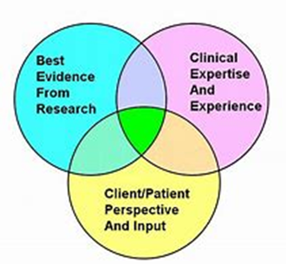
Recap
In pairs/ small group, (5 minutes)
Explain qualitative and quantitative research methodology
How does qualitative and quantitative research methodology lead to service improvement in evidence-based practice
Group feedback to the class

Slide 5
LO1 Activity (10 minutes)
https://youtu.be/Ry_54WleO7Y
Group
In small group, with extracts from the video clip,
Define
Define the literature review concept
Explain
Explain the purpose of Literature review in the research process.

Slide 6

Now ….what is literature review?
Literature reviews are secondary sources, and do not report new or original experimental work.
This investigation should provide a description, summary, and critical evaluation of works related to the research problem or topic and should also add to the overall knowledge of the topic as well as demonstrating how your research will fit within a larger field of study
A literature review is a comprehensive summary of previous research on a topic. A literature review surveys books, scholarly articles, and any other sources relevant to a particular issue, area of research, or theory, and by so doing, provides a description, summary, and critical evaluation of these works in relation to the research problem being investigated.
The Literature refers to the collection of scholarly writings on a topic. This includes peer-reviewed articles, books, dissertations and conference papers. When reviewing the literature, be sure to include major works as well as studies that respond to major works. (Laverne.libguides.com, 2019).

Slide 7
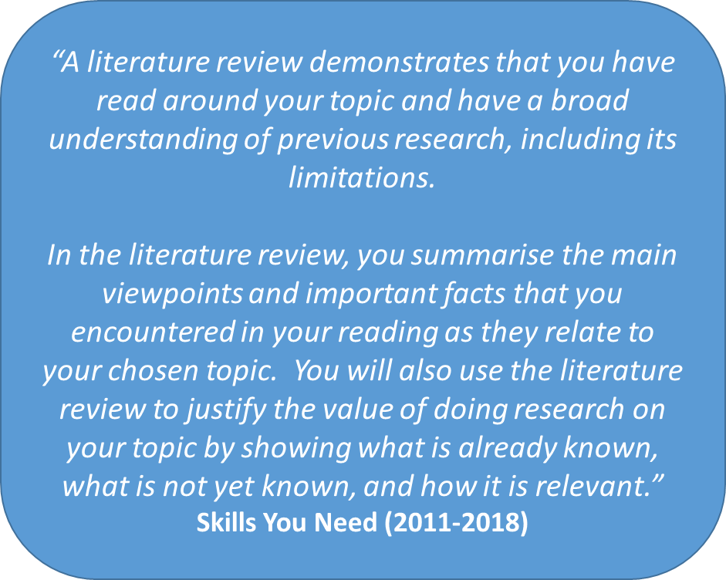

Slide 8
Keep your audience / reader in mind – be sure to write to the level of your reader
Use subheadings to clarify your structure – it will make your review more manageable to read and “chunks” the information
Use evidence
Be selective – pick the most important points from each source
Paraphrasing is preferred to using many direct quotes – this allows you to use your own voice and show your understanding of the research
Do not cite references you have not read
Writing the Literature Review

Slide 9
LO1 Activity (10 minutes)
Individually
Research the meaning of literature review
Feedback to the class

Slide 10

A literature review
The literature review is a critical discussion and summary of statistical literature that is of ‘general’ and ‘specialized’ relevance to the particular area and topic of the research problem in statistics.
It surveys the literature in your chosen area of study.
It synthesizes the information in that literature into a summary.
A literature review provides context, informs methodology, maximizes innovation, avoids duplicative research, and ensures that professional standards are met.
A literature review in a proposal should be long enough to convince your committee that you have thoroughly explored the research topic.

Slide 11
Why do we need a literature review
To identify data sources that other researchers have used. ... To contribute to the field by moving research forward. Reviewing the literature lets you see what came before, and what did and didn't work for other researchers. To demonstrate your understanding, and your ability to critically evaluate research in the field.
A good literature review will not only summarize the information, but also point out weaknesses in the experimental procedures as well as possible theoretical conflicts. It builds on the current knowledge by identifying gaps in the available literature and suggesting future directions for research.

Slide 12

What is the main purpose of literature review?
The purpose of a literature review is to:
Provide foundation of knowledge on topic. Identify areas of prior scholarship to prevent duplication and give credit to other researchers. Identify inconstancies: gaps in research, conflicts in previous studies, open questions left from other research.
A literature review is to offer an overview of existing literature on a specific topic along with an evaluation of the strengths and weaknesses of the author’s arguments.
You are summarizing what is available on a certain topic and then drawing conclusions about the topic. To make gathering your research easier, be sure to start with a narrow/specific topic and then widen your topic if necessary.

Slide 13
Finding Relevant Literature
As part of your initial reflection, you should find out whether there is any relevant literature to aid your particular project.
The educational literature is now so extensive that it is unlikely that there isn’t.
You could save time reading numerous journal articles if you can locate a book or review relevant to your problem (Guides.lib.vt.edu, 2019).

Slide 14
The purpose of a literature review is to:
Provide
Provide foundation of knowledge on topic
Identify
Identify areas of prior scholarship to prevent duplication and give credit to other researchers
Identify
Identify inconstancies: gaps in research, conflicts in previous studies, open questions left from other research
Identify
Identify need for additional research (justifying your research)
Identify
Identify the relationship of works in context of its contribution to the topic and to other works
Place
Place your own research within the context of existing literature making a case for why further study is needed.
(Uscupstate.libguides.com, 2019)

Slide 15

Importance of literature review in research
The literature review is important because:
It describes how the proposed research is related to prior research in statistics.
It shows the originality and relevance of your research problem. Specifically, your research is different from other statisticians. It justifies your proposed methodology.
It demonstrates your preparedness to complete the research.
Every statement in a literature review must be supported either by a reference to published statistical literature.
Literature reviews give a conceptual framework for research or project planning because students can have a clear idea of what has already been done in the field.
This helps students build up new research topics on the basis of existing literatures. Can substitute with computers.

Slide 16

Conducting a literature review using various resources – secondary sources
Textbooks
Specialist books
Journals
Sector magazines
Commissioned reports
Regulator reports
Government organisation websites
Google Scholar
www
NHS
Charities
Leaflets
Social media
Pubmed

Slide 17
WRAP-UP
Question and Answer Session

Slide 18
Glossary of different health care Perspectives
BMA: British Medical Association
BMJ-British Medical Journal
CCG: Clinical Commissioning Groups
DCN: District Councils Network
DPH: Director of Public Health
GP: General Practitioner
HWB(s): Health and Wellbeing Board(s)
JSNA: Joint Strategic Needs Assessment
JHWS: Joint Health and Wellbeing Strategy
RCN: Royal College of Nursing
LSHTM: London School of Hygiene and Tropical Medicine
NHSE: NHS England
PCT: Primary Care Trust
PHE: Public Health England
PHOF: Public Health Outcomes Framework
PRUComm: Policy Research Unit in Commissioning and the Health Care System
UKFPH: UK Faculty of Public Health

Slide 19
Homework Reading techniques
Scanning
Skimming
In pairs, explain
Why are these important when carrying out a literature review?

Slide 20
Bibliography
The Royal Literary Fund. (2019). The structure of a literature review. [online] Available at: https://www.rlf.org.uk/resources/the-structure-of-a-literature-review/ [Accessed 19 Nov. 2019].
Uscupstate.libguides.com. (2019). LibGuides: Literature Review: Purpose of a Literature Review. [online] Available at: https://uscupstate.libguides.com/c.php?g=627058&p=4389968 [Accessed 19 Nov. 2019].
Scribbr. (2019). Reliability vs Validity in Research | Differences, Types and Examples. [online] Available at: https://www.scribbr.com/methodology/reliability-vs-validity/ [Accessed 19 Nov. 2019].
Golafshani, N., 2003. Understanding reliability and validity in qualitative research. The qualitative report, 8(4), pp.597-606.
Cronin, P., Ryan, F. and Coughlan, M., 2008. Undertaking a literature review: a step-by-step approach. British journal of nursing, 17(1), pp.38-43.
Golafshani, N., 2003. Understanding reliability and validity in qualitative research. The qualitative report, 8(4), pp.597-606.
McCusker, K. and Gunaydin, S., 2015. Research using qualitative, quantitative or mixed methods and choice based on the research. Perfusion, 30(7), pp.537-542.
Scribbr. (2019). Reliability vs Validity in Research | Differences, Types and Examples. [online] Available at: https://www.scribbr.com/methodology/reliability-vs-validity/ [Accessed 19 Nov. 2019].

Slide 21
Bibliography
Williamson, G.R., Bellman, L. and Webster, J., 2011. Action research in nursing and healthcare. Sage.
Meyer, J., 2000. Using qualitative methods in health related action research. Bmj, 320(7228), pp.178-181.
Libguides.ithaca.edu. (2019). LibGuides: Research 101: Primary and Secondary Sources. [online] Available at: https://libguides.ithaca.edu/research101/primary [Accessed 12 Nov. 2019].
Hox, J.J. and Boeije, H.R., 2005. Data collection, primary versus secondary.
Bryman, A., 2006. Integrating quantitative and qualitative research: how is it done?. Qualitative research, 6(1), pp.97-113.
McCusker, K. and Gunaydin, S., 2015. Research using qualitative, quantitative or mixed methods and choice based on the research. Perfusion, 30(7), pp.537-542.
Lieber, E., 2009. Mixing qualitative and quantitative methods: Insights into design and analysis issues. Journal of Ethnographic & Qualitative Research, 3(4).

